Slide 1
Project Topic : School admission Management System
Group No. : 28
Name Of Students :Omkar Sathe
Hrishikesh Jagtap

Slide 2
Synopsis
Project Title: | School Management Management system
Name of the Company: | M.E.S. Boys Highschool
Technology: | Java MS Access
Team Members: | OmkarSathe HrushikeshJagtap
Objectives: | The main objective of the project is to manage the details of the school , students , class & teachers. The project is totally built at administrator end and thus only administrator is guaranteed the access. The purpose of the project is to build an application program to reduce work for managing the schools, class wise admission details.
Modules: | Login Module School Information Module School Management Module Fees Payment module Search Module Admission Module

Slide 3
Project Profile
School Admission Management is becoming very essential component in education in this modern day age . With the help of school admission system we can gather all the useful information needed to the management in few clicks . Schools Admission System consists of different modules such as Logic , forms and reports , our main purpose is to create software which will manage the working of these different modules.
School Admission System is the Intranet based which will help the student to the admission , view attendance , view Results , etc. With the help of this system admin can easily maintain the records of many students without any paperwork. Admin can find information of any student easily. The software manages the information about various users including faculties , information about subjects offered in various semisters, marks obtained by students in different semisters , daily attendance for employees and students and staff.

Slide 4
Company profile
Name of the company : My Wings Honda Showroom.
Head Office : Pune, Maharashtra.
Key People :Vasudev Balwant Phadke.
Website : bhavehighschool.org
BhaveHighschool was established in 1860(Also known as M.E.S. Boys Highschool) is a school and junior college based in Pune , Maharashtra , India .The Institution is run by the Maharashtra Education Society. A Private Education Institution founded by Vasudev Balawant Phadke ,Vaman Prabhakar Bhave and Laxman Narhar Indapurkar in 1860.

Slide 5
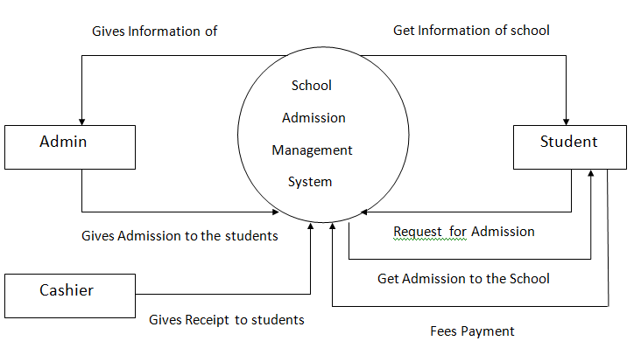
Context level diagram

Slide 6
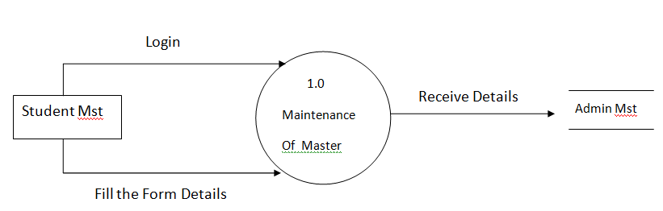
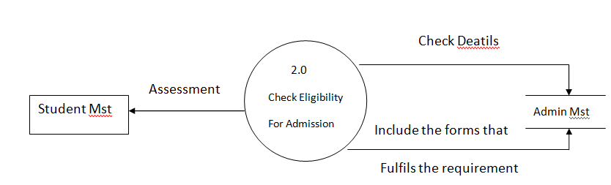
Data flow diagram

Slide 7
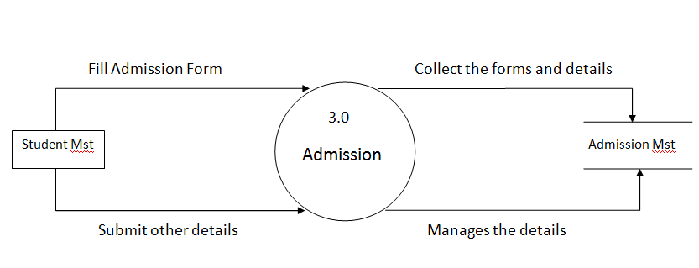
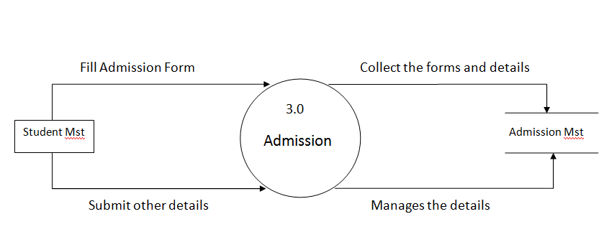

Slide 8
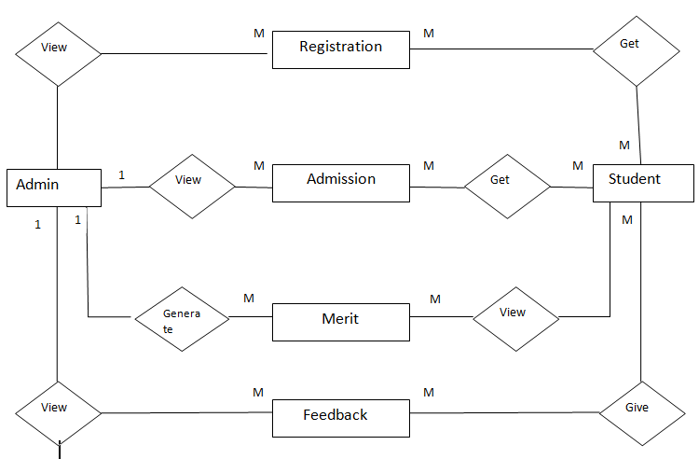
Entity relationship diagram

Slide 9
Table design
Table no. 1
Login Master
Column Name | Datatype | Size | Constraint | Description
usernm | Text | 20 | Primary key | User Name
password | Number | 8 | Not Null | Login password
que | Text | 50 | Not Null | Security Question
Table no. 2
Fifth Standard Admission Master
Column Name | Datatype | Size | Constraint | Description
Stud_id | Number | 10 | Primary key | Student ID
Stud_fname | Text | 30 | Not Null | Student First name
Stud_mname | Text | 30 | Not Null | Student Middle name
Stud_surname | Text | 30 | Not Null | StudentSurname
dob | Number | 10 | Not Null | Date of Birth
contact | Text | 10 | Not Null | Contact number
address1 | Text | 50 | Not Null | Address 1
address2 | Text | 50 | Not Null | Address 2
houseno | Number | 10 | Not Null | House number
pincode | number | 10 | Not Null | Pincode
medium | Text | 20 | Not Null | Medium for admission
pic | Text | - | Not Null | Picture of students

Slide 10
Table no. 3
Sixth Standard Admission Master
Column Name | Datatype | Size | Constraint | Description
Stud_id | Number | 10 | Primary key | Student ID
Stud_fname | Text | 30 | Not Null | Student First name
Stud_mname | Text | 30 | Not Null | Student Middle name
Stud_surname | Text | 30 | Not Null | StudentSurname
dob | Number | 10 | Not Null | Date of Birth
contact | Text | 10 | Not Null | Contact number
address1 | Text | 50 | Not Null | Address 1
address2 | Text | 50 | Not Null | Address 2
houseno | Number | 10 | Not Null | House number
pincode | number | 10 | Not Null | Pincode
medium | Text | 20 | Not Null | Medium for admission
pic | Text | - | Not Null | Picture of students

Slide 11
Table no. 4
Seventh Standard Admission Master
Column Name | Datatype | Size | Constraint | Description
Stud_id | Number | 10 | Primary key | Student ID
Stud_fname | Text | 30 | Not Null | Student First name
Stud_mname | Text | 30 | Not Null | Student Middle name
Stud_surname | Text | 30 | Not Null | StudentSurname
dob | Number | 10 | Not Null | Date of Birth
contact | Text | 10 | Not Null | Contact number
address1 | Text | 50 | Not Null | Address 1
address2 | Text | 50 | Not Null | Address 2
houseno | Number | 10 | Not Null | House number
pincode | number | 10 | Not Null | Pincode
medium | Text | 20 | Not Null | Medium for admission
pic | Text | - | Not Null | Picture of students

Slide 12
Table no. 5
Eighth Standard Admission Master
Column Name | Datatype | Size | Constraint | Description
Stud_id | Number | 10 | Primary key | Student ID
Stud_fname | Text | 30 | Not Null | Student First name
Stud_mname | Text | 30 | Not Null | Student Middle name
Stud_surname | Text | 30 | Not Null | StudentSurname
dob | Number | 10 | Not Null | Date of Birth
contact | Text | 10 | Not Null | Contact number
address1 | Text | 50 | Not Null | Address 1
address2 | Text | 50 | Not Null | Address 2
houseno | Number | 10 | Not Null | House number
pincode | number | 10 | Not Null | Pincode
medium | Text | 20 | Not Null | Medium for admission
pic | Text | - | Not Null | Picture of students

Slide 13
Table no. 6
Ninth Standard Admission Master
Column Name | Datatype | Size | Constraint | Description
Stud_id | Number | 10 | Primary key | Student ID
Stud_fname | Text | 30 | Not Null | Student First name
Stud_mname | Text | 30 | Not Null | Student Middle name
Stud_surname | Text | 30 | Not Null | StudentSurname
dob | Number | 10 | Not Null | Date of Birth
contact | Text | 10 | Not Null | Contact number
address1 | Text | 50 | Not Null | Address 1
address2 | Text | 50 | Not Null | Address 2
houseno | Number | 10 | Not Null | House number
pincode | number | 10 | Not Null | Pincode
medium | Text | 20 | Not Null | Medium for admission
pic | Text | - | Not Null | Picture of students

Slide 14
Table no. 7
Tenth Standard Admission Master
Column Name | Datatype | Size | Constraint | Description
Stud_id | Number | 10 | Primary key | Student ID
Stud_fname | Text | 30 | Not Null | Student First name
Stud_mname | Text | 30 | Not Null | Student Middle name
Stud_surname | Text | 30 | Not Null | StudentSurname
dob | Number | 10 | Not Null | Date of Birth
contact | Text | 10 | Not Null | Contact number
address1 | Text | 50 | Not Null | Address 1
address2 | Text | 50 | Not Null | Address 2
houseno | Number | 10 | Not Null | House number
pincode | number | 10 | Not Null | Pincode
medium | Text | 20 | Not Null | Medium for admission
pic | Text | - | Not Null | Picture of students

Slide 15
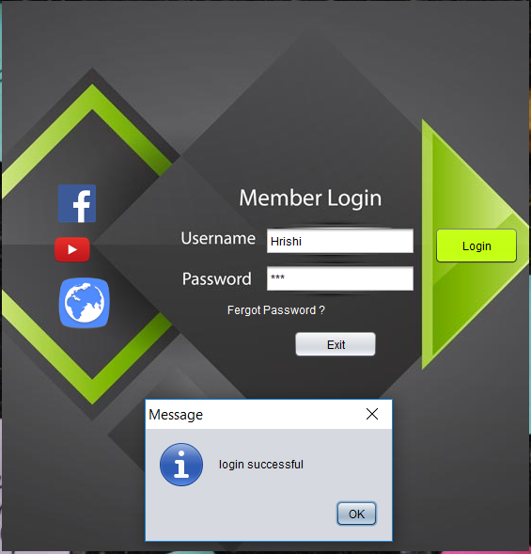
Login Form

Slide 16

MDI Form

Slide 17
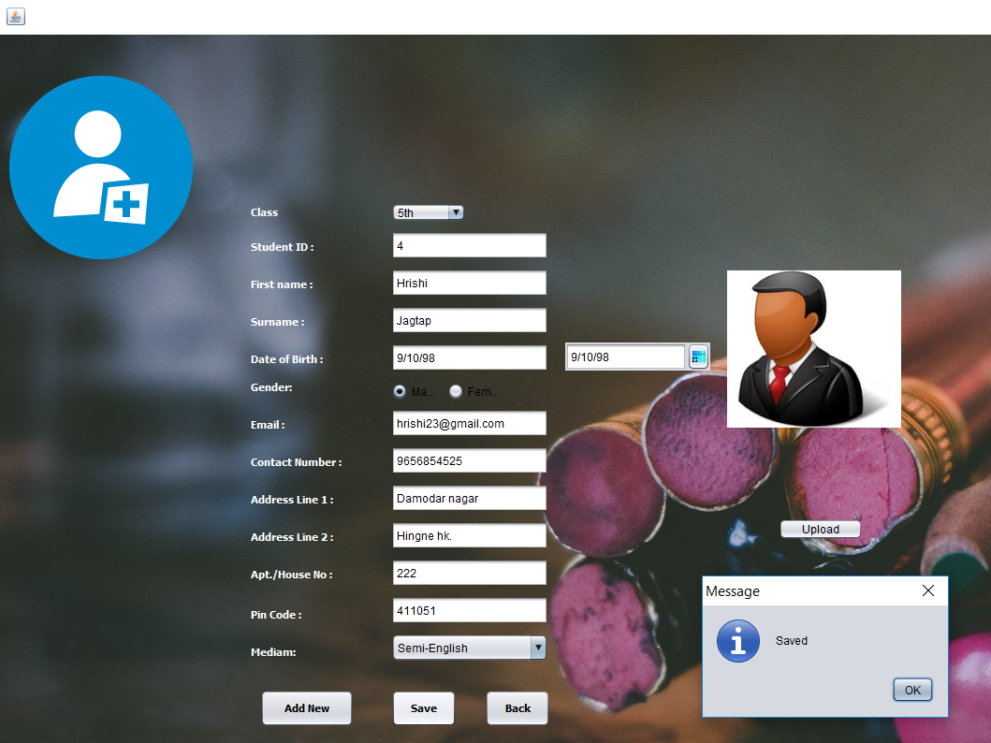
Admission Form

Slide 18
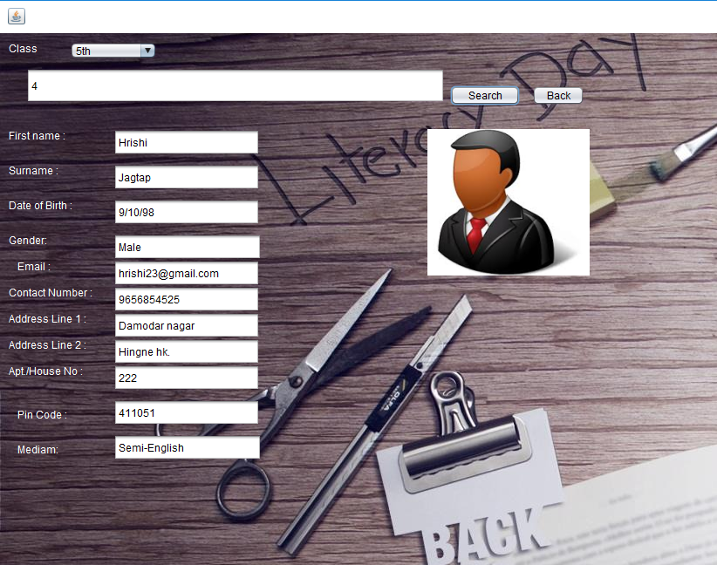
Search Form

Slide 19
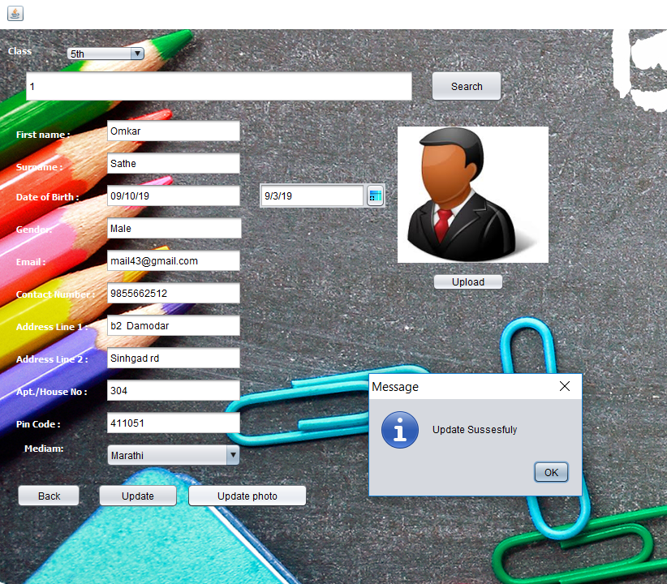
Update Form

Slide 20
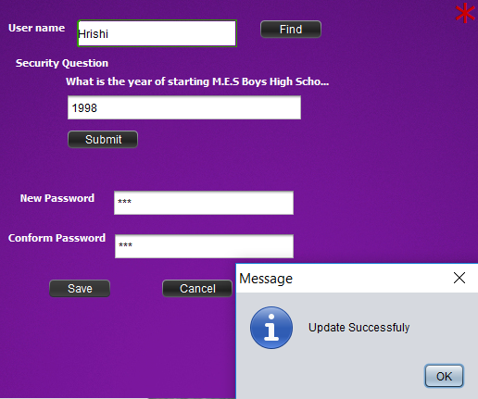
Forgot Password

Slide 21
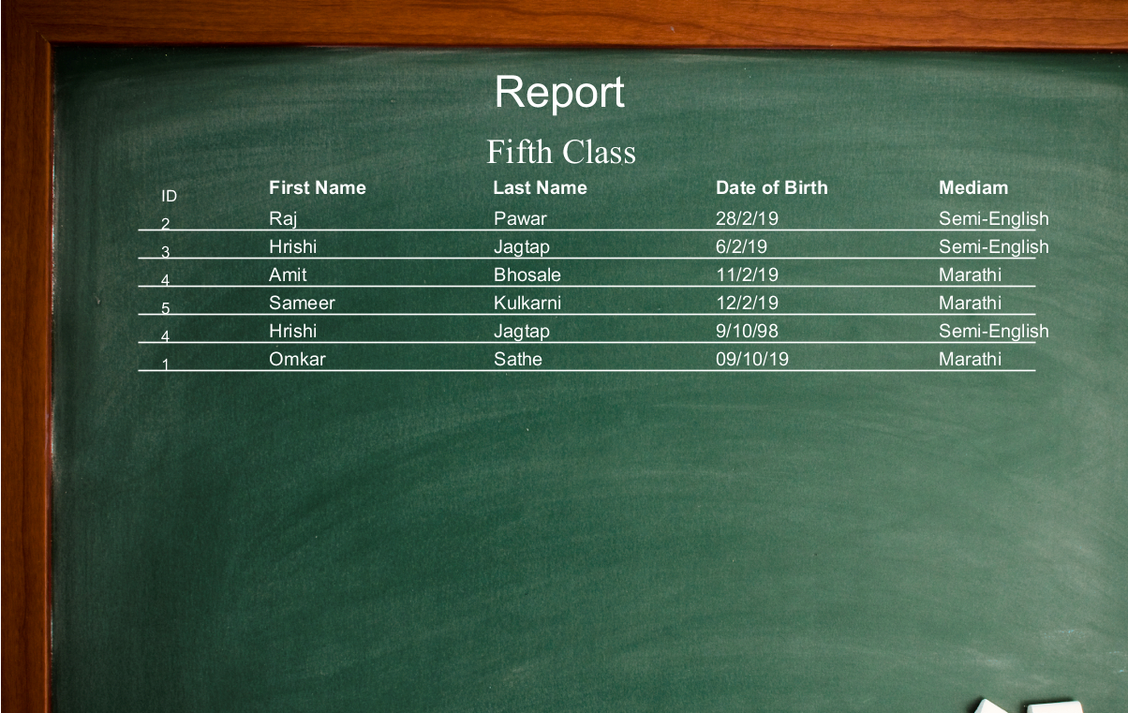
Reports

Slide 22
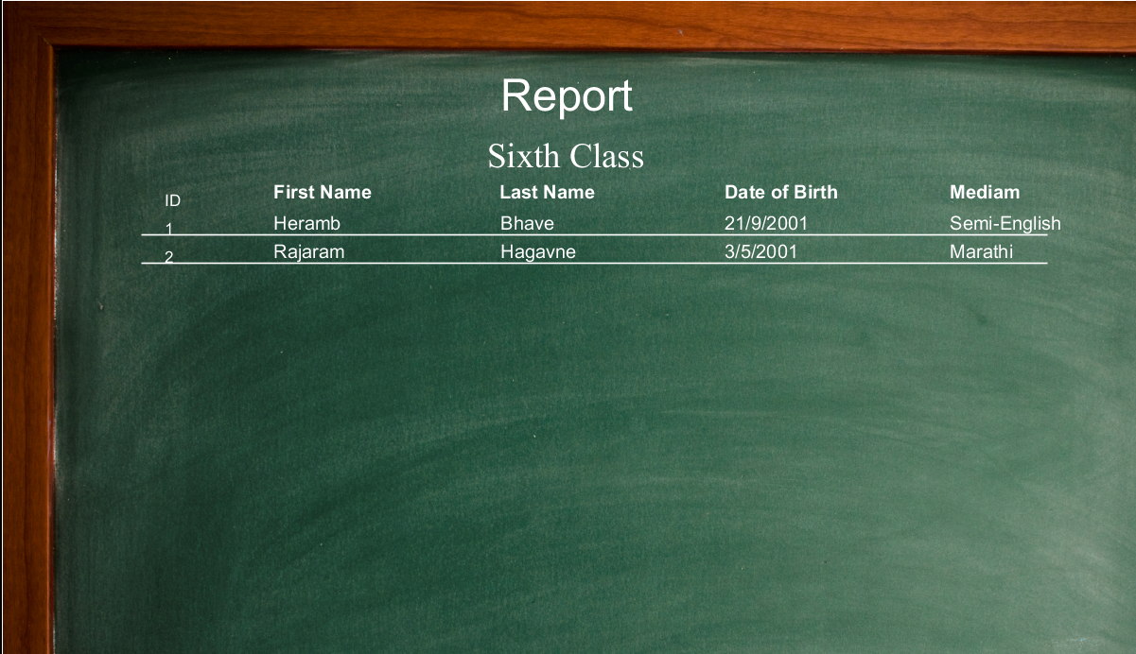

Slide 23
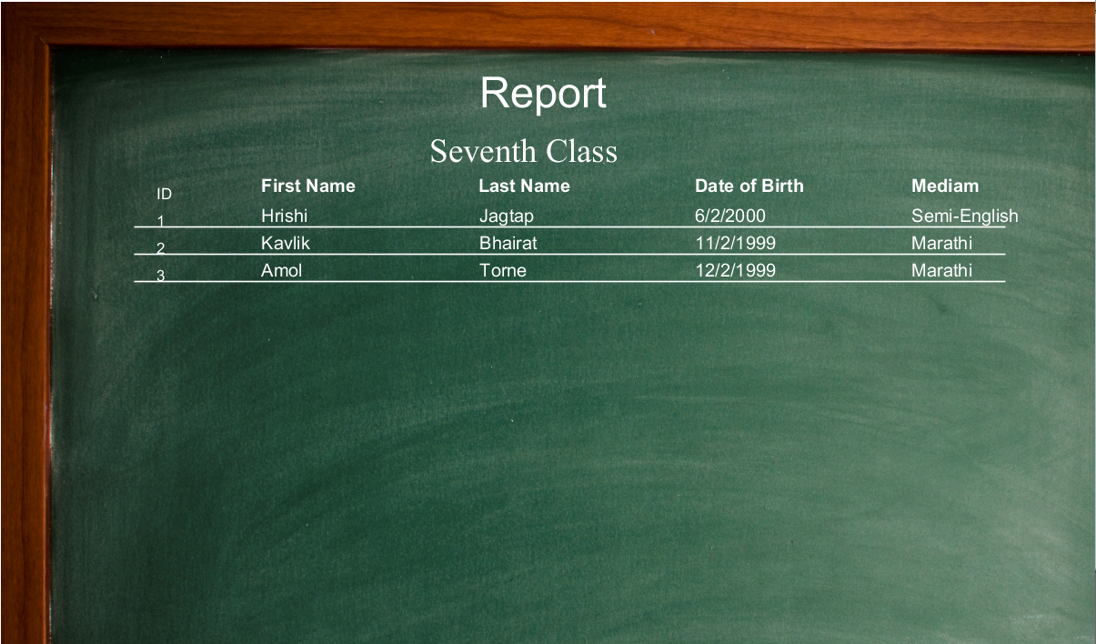

Slide 24
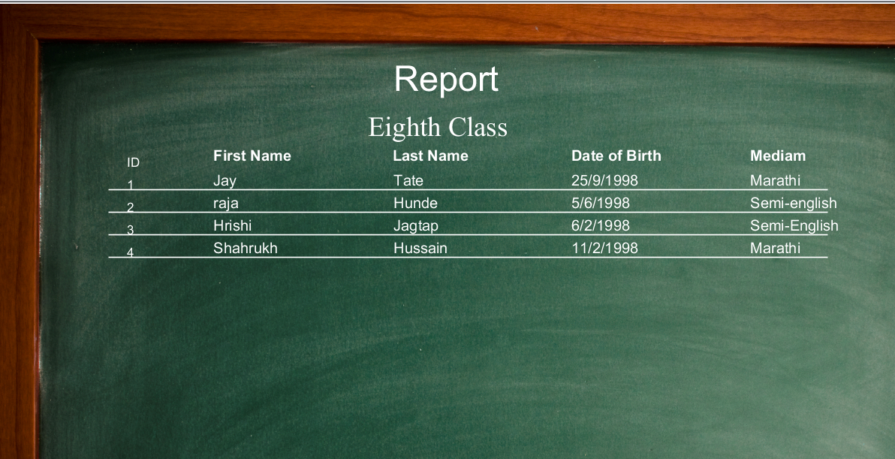

Slide 25
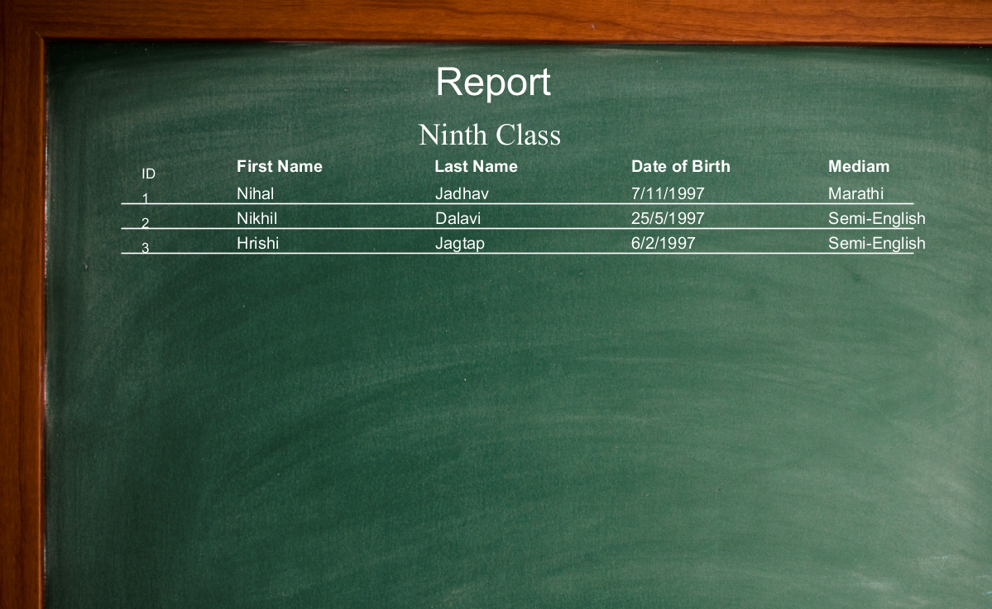

Slide 26
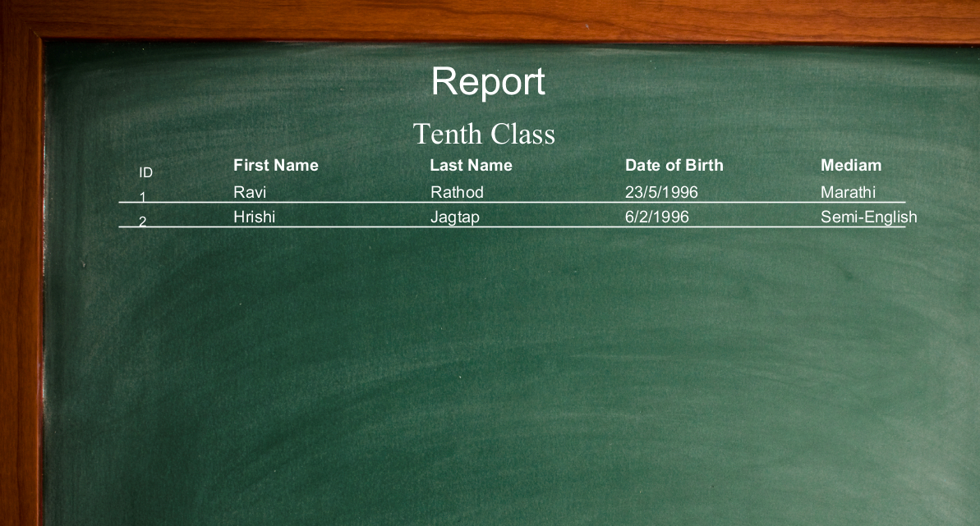

Slide 27
Thank You !!!

